Slide 1
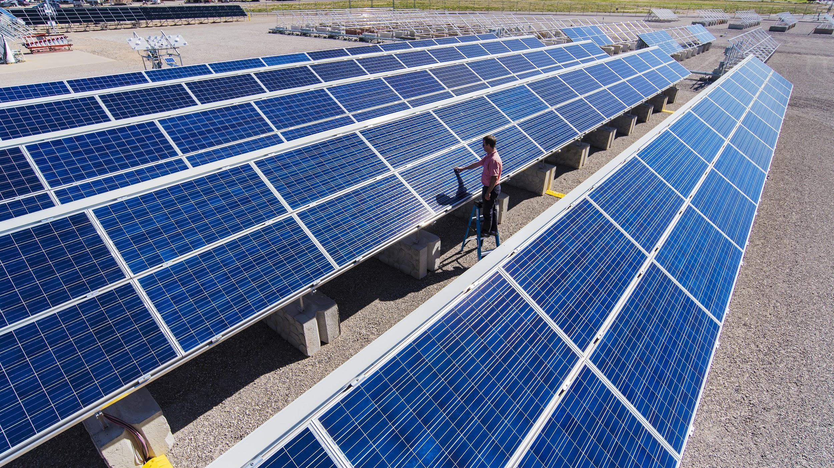

RTC Data Project
Ashley Otero
HCI 598

Slide 2
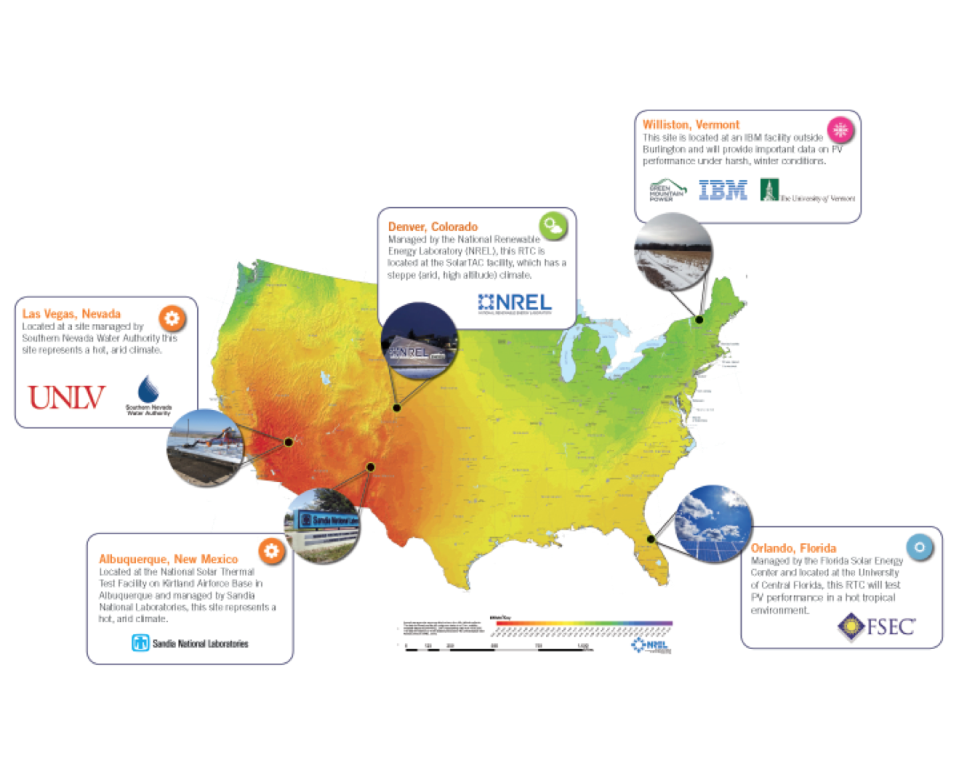
Overview of the RTCs
Regional Test Centers (RTC) are field sites that:
Test PV products in a variety of climates
Collect performance and reliability data
Department of Energy (DOE) federally funds
Sandia National Laboratories provides work
Notes:
The Department of Energy (DOE) has been federally funding Sandia National Laboratories to provide system field performance and degradation monitoring data via the Regional Test Center (RTC) data project. The RTCs are field sites that test PV products in a variety of climates and for photovoltaic performance and reliability.

Slide 3
Overview of the RTCs
Data is collected and must be public (with the exception of proprietary data)
Purpose of project:
1) engage with external industry partners to allow for a more self-sustaining business model
2) validate the necessity and value in the research
Notes:
The DOE has mandated that funded research must be publicly accessible and searchable at no charge to readers. Proprietary data is exempt from this mandate.
Introductory knowledge on photovoltaic systems is assumed, as it is outside the scope for the system.
Meaningful application and visualization of the data allows for greater dissemination of the photovoltaic performance and reliability, which in turn will: 1) potentially engage with external industry partners to allow for a more self-sustaining business model for the RTCs, and 2) validate the necessity and value in the research taking place at the RTCs for the DOE.

Slide 4
Design Problem
Non-proprietary data should be publically available - no current way to access this data
RTC sites are continually gathering a backlog of data with no path forward to disseminate
Data Collection
Data Repository
Public Accessibility

Slide 5
Target Users
Researchers
Highly scientific & technical
Most have a Ph.D. in their field
Very familiar with meaning of data collected by the photovoltaic systems
Have ideas about displaying data
Have ideas on what type of visualizations will be valuable
Basic computing skills
Industry
Highly technical
Education varies
Very familiar with meaning of data collected by the photovoltaic systems
Desire proprietary data
Would like to manipulate dashboards and visualizations
Basic computing skills

Slide 6
Approach to the Solution
Used actual baseline and weather system data
Reasons for high-fidelity:
Work faster in code
Can quickly iterate on versions after user feedback
Allows for reusability later
Belief in programming best practice of “don’t repeat yourself”
Use abstraction methods to modularize code into reusable components (Wilson, et al., 2014)
More realistic system response, doesn’t break user flow between action and response time (Pernice, 2016)
High Fidelity Web Based Prototype
Notes:
Since I had access to real data, I decided to create a high-fidelity prototype as using real data in a test application is “essential for understanding how the proposed design matches the needs of target users.” (Roth, Hart, Mead, & Quinn, 2016)

Slide 7
Approach to the Solution
Solution: a web system to ingest and display data and visualizations
Identified 3 main user tasks
High Fidelity Web Based Prototype
Export data based on a specific set of user-defined criteria.
Find site specific information such as technical specifications and location.
Manipulate a visualization of data based on a specific set of user-defined criteria.

Slide 8
Design Tradeoffs
Multiple Audiences
Researchers were unsure if the general public would understand the use and value of the system without significant instruction.
This led to the addition of data type definitions.
Comparison Data
Comparison data is limited to sites with multiple identical arrays setups by different module manufacturers.
Easier to normalize the variances and compare visualization data produced by each site.
Reduces amount of potential data filters, therefore reducing cognitive load.
Reduces end user’s computing resources.
Responsive Design
Due to the amount of data types available for public data, it is not feasible to optimize the design for devices smaller than a landscape tablet.
Users expected to use the tool in a desktop or laptop setting.
Users were uncomfortable storing files (XLS, PDF, JPG, etc.) on their phone or tablet devices.

Slide 9
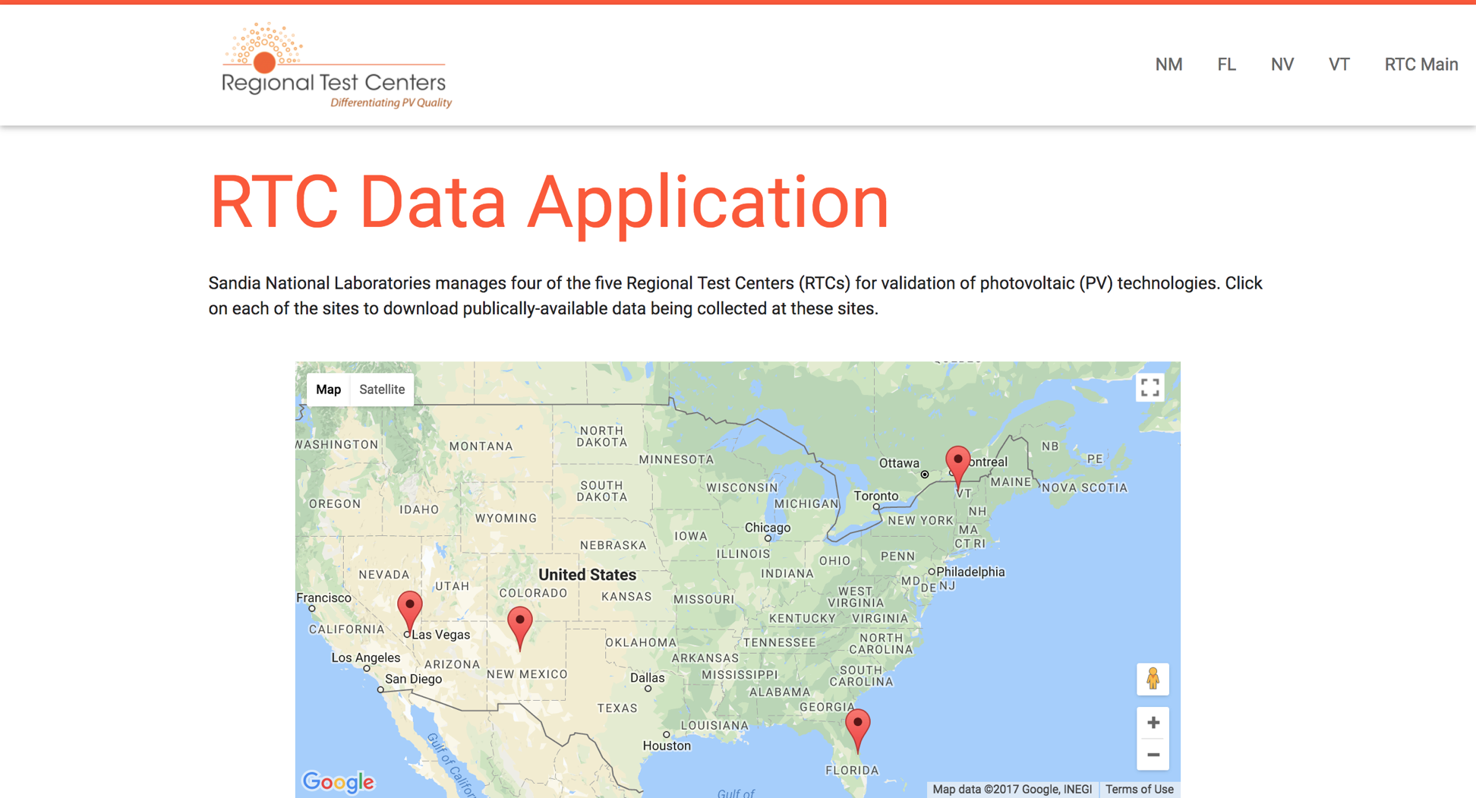
The Prototype: Homepage
Top navigation to the four sites that we have data for – New Mexico, Florida, Nevada, and Vermont
Link back to the main RTC web site
Persistent header
Embedded Google Map with dropped pins locating each of the RTC sites

Slide 10
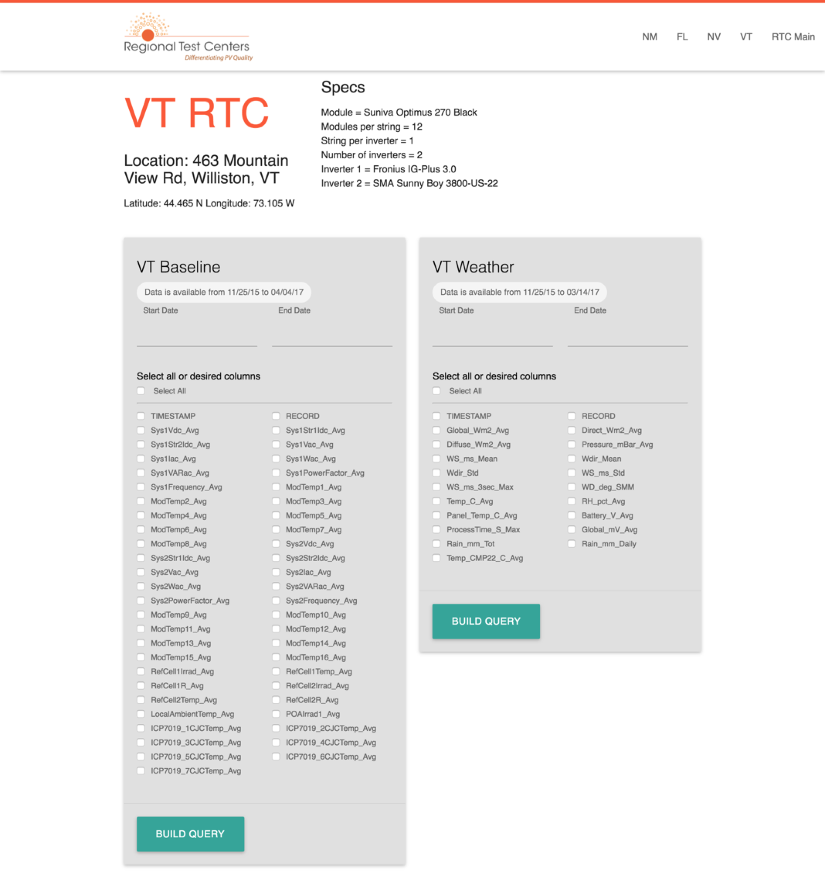
The Prototype: Site Pages
Details including: location, technical specifications, photos, and climate data
Contains both systems (weather and baseline)
System data types

Slide 11
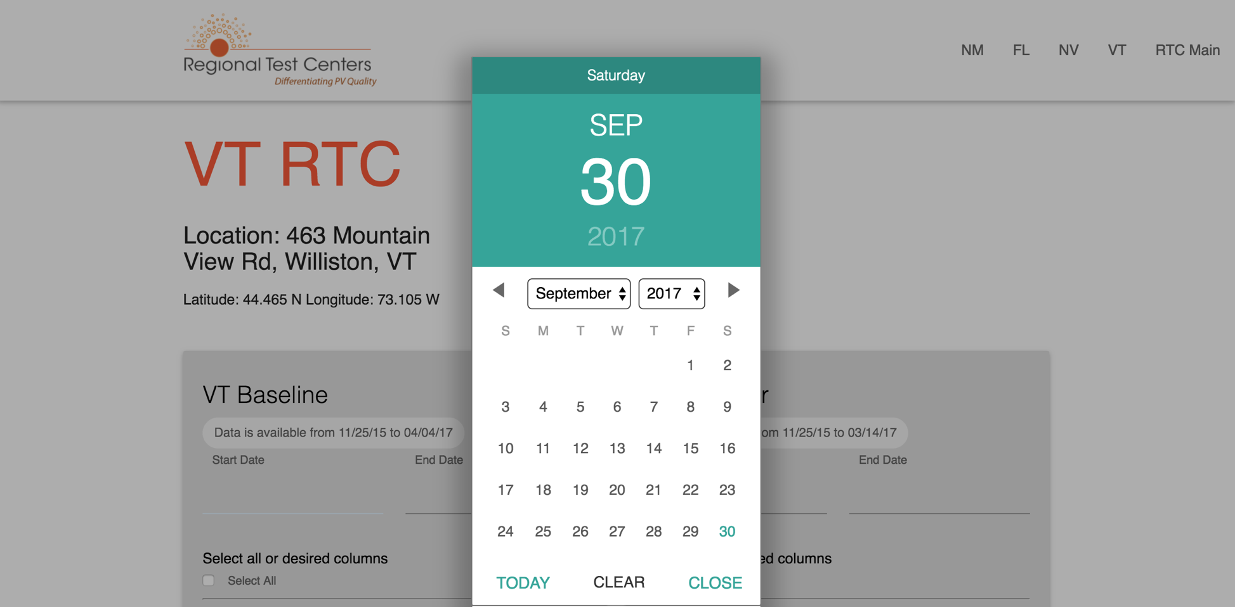
The Prototype: Site Pages - Query
User can select a date range from either available system
System automatically queries the database for the limits of available data

Slide 12
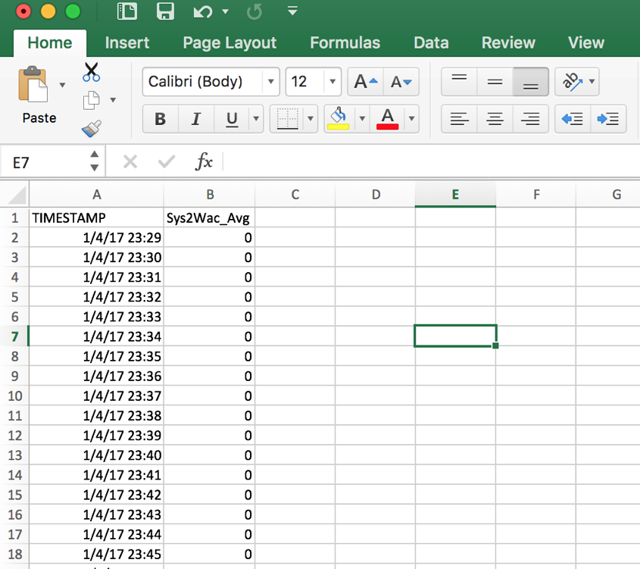
The Prototype: Site Pages - Results
User selects one or more data types and clicks “Build Query”
Database builds the query, user’s browser will prompt them to save a CSV
The file will reflect the data types as columns, days as rows

Slide 13
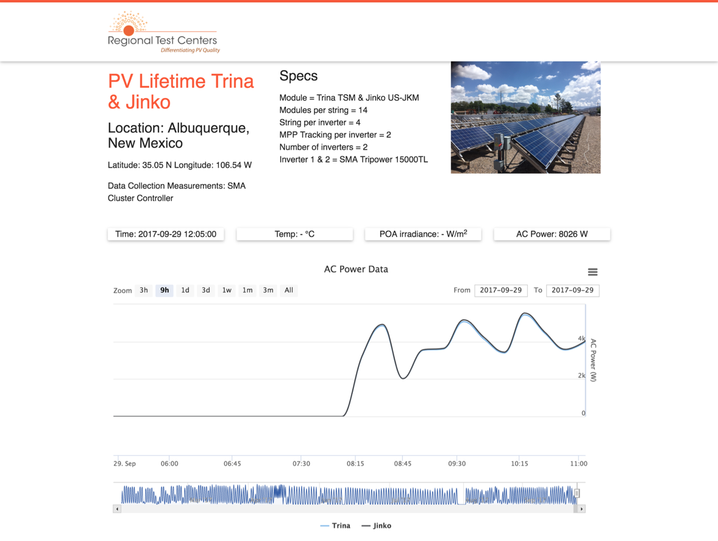
The Prototype: Visualization
Adjusting the date range/time
Zooming in or out to increase or decrease the focus on a particular set of data
Filter by toggling the specific modules that can be compared side by side
Users can download a snapshot of the visualization as PNG, JPG, PDF, or SVG

Slide 14
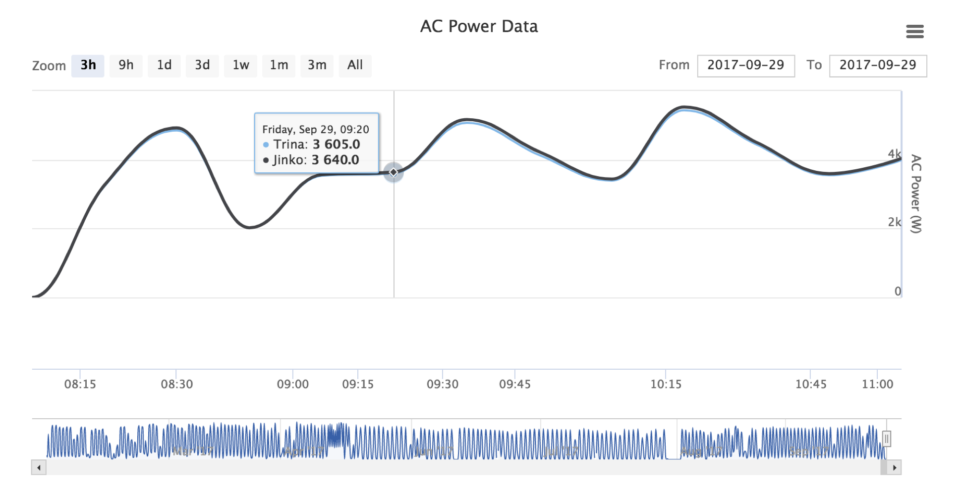
The Prototype: Visualization
(hover state)

Slide 15
User Feedback & Evaluation Data
Methods
Pre-test questions & demographics
Post-test questions (thoughts on the system)
Two post-test questionnaires
Usefulness, Satisfaction, and Ease of Use
System Usability Scale

Slide 16
User Demographics
Role | Role | Role | Education | Time w/ SNL | Prev. Role | RTC? | Solar? | Tech?
A | Male, early 30s | Researcher | MS | 4 years | Tech company | Yes | Yes | Yes
B | Male, early 50s | Senior Scientist | Ph.D | 13 years | Other lab | Yes | Yes | Yes
C | Female, mid 20s | Communications Specialist | BA | 18 months | Private sector | Yes | Yes | Somewhat
D | Female, mid 20s | Project Controller | MBA | 2 years | Private sector | Yes | Yes | Somewhat
E | Female, late 50s | Principle Investigator | Ph.D | 5 years | Academia | Yes | Yes | Yes
F | Male, late 20s | Technical Staff | MS | 8 years | Student | Yes | Yes | Yes
Notes:
Users were asked demographic and background questions before the usability testing session took place.
1. What is your current role or job title?
2. What is your educational background (BA/BS, MS, Ph.D.)?
3. How long have you been with Sandia?
4. What was your previous role before coming to Sandia?
5. Are you familiar with the RTC program?
6. Are you familiar with the solar industry?
7. Do you consider yourself a technical person?

Slide 17
Feature Request: 1
Usability Issues by Severity
Cosmetic Problem: 2
Minor Problem: 4
Major Problem: 1
Must Fix: 3
Notes:
There were repeated instances of what I assumed to be clear and obvious interactions for the user proving to be not quite so. My naming convention of “Build Query” on the forms for exporting data was a mismatch from the task instruction of “export CSV,” which proved to be a stumbling point for all six users tested.
Feature Request: Asked for system definitions in a tooltip
Cosmetic: Was unsure of system definitions purpose, Was confused by error thrown by Excel on CSV open
Minor: Didn't see top navigation on home page, Thought time/temp/etc on visualization page was clickable, Found specs redundant on visualization, Thought colors between two systems were too hard to distinguish
Major: Didn't see data available dates
Must fix: Didn't see start/end date, Issue loading site from map, Didn't realize Build Query would export CSV

Slide 18
Usefulness, Satisfaction, & Ease of Use Results
Scores were wildly variable
Difficult to obtain tangible action items
Averages for users: 6.3, 5.7, 6.9, 4.3, 5.1, 4.3
The highest average scores for an individual question was tied: “I don't notice any inconsistencies as I use the system” and “I easily remember how to use the system”
Overall Avg. Score:
5.4
Highest Score Questions:
6.33

Slide 19
System Usability Scale Results
SUS score is suspect, given the amount of usability issues encountered during the test
Results of the SUS should be discarded for any use other than historical comparison between iterations
Results don’t appear to be accurate, doesn’t give any weight to the efficacy of the current design
SUS Score:
81.25
Industry Average:
68

Slide 20
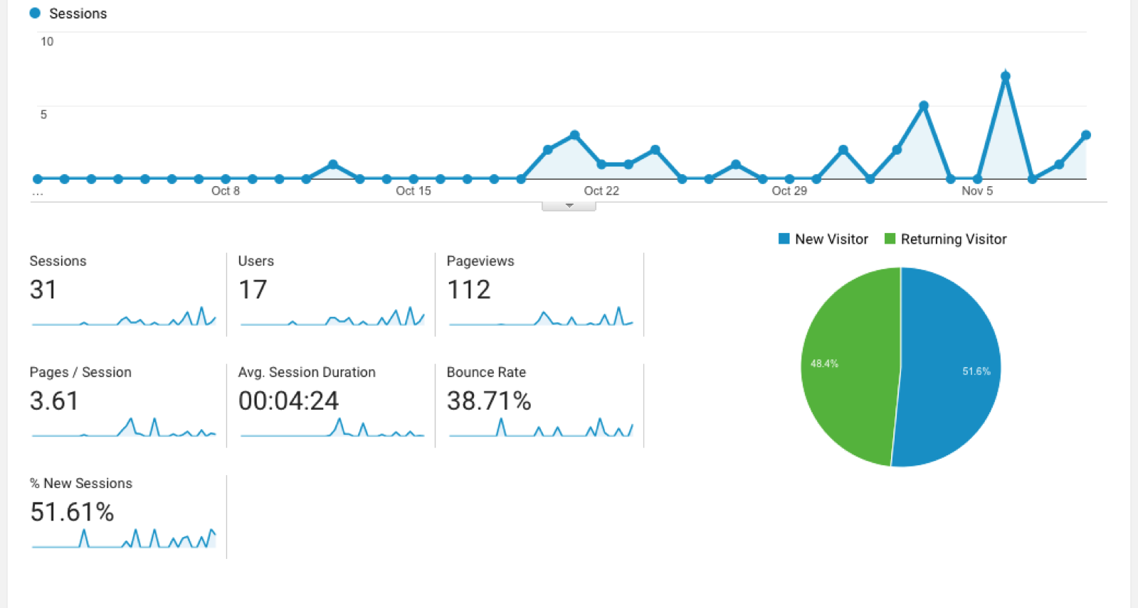
Google Analytics Results
Dates of October 1, 2017 through November 9, 2017
No sessions or users were excluded
Number of unique users/sessions greater than expected
Users must have returned after the usability test was over

Slide 21
Reflections & Lessons Learned
Would have liked to have significantly more users to test
Next time, will plan usability testing far in advance
Make a usability testing task during each sprint during each sprint for ongoing iterations
Add other types of testing (timed task completion, eye tracking/heatmap, and overall cognitive load)
Add another proctor for the testing to run the test so I can focus on feedback and note taking
Rely less on SUS, use only as a baseline between iterations
Continue to incorporate analytics data where applicable

